Slide 1
HCRI: A Linguistic QA/CA Project
Enrico Trombetta
Jeff Dalton as supervisor
Iain Mackie as mentor

Slide 2
Content
Introduction and Problem Statement
Limitations of SOTA CAs
Research Questions
  What is a linguistic question/agent?
  What types of multi-term dialogue would users pose?
  What data sources can empower such system
  How do we answer those questions?
PoC
Future Work

Slide 3
Introduction and Problem Statement
Harper Collins Glasgow is interested in improving their products (online mono/bilingual dictionaries) with a QA system to make user interaction less daunting.
The School is interested in providing a domain-specific QA system in the form of a CA that could address linguistic questions.

Slide 4
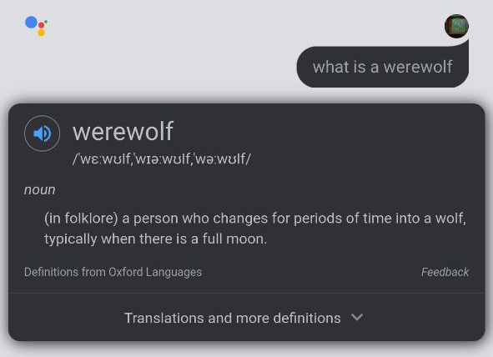
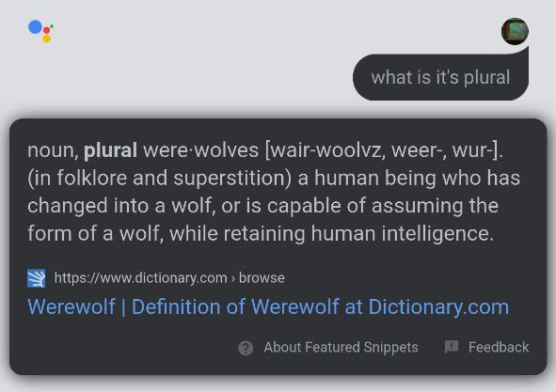
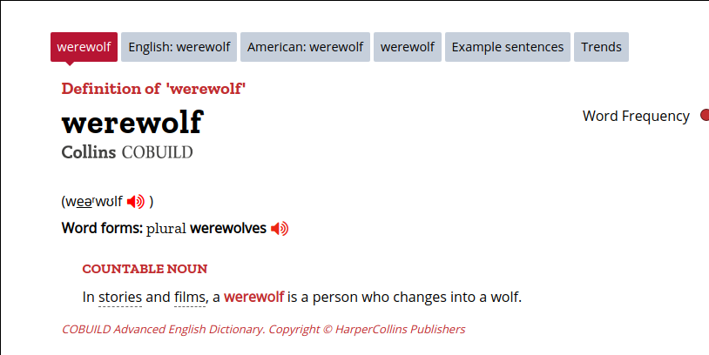
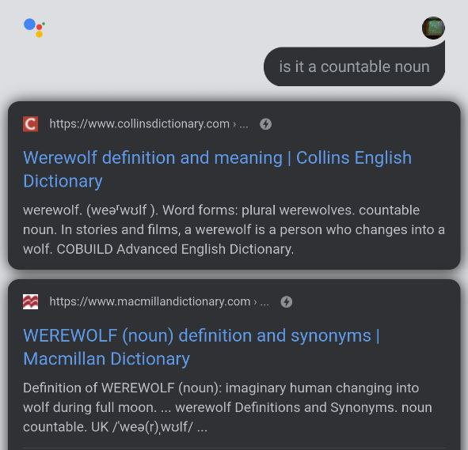
QA/CA for dictionaries
Watch out the “it’s”!

Slide 5
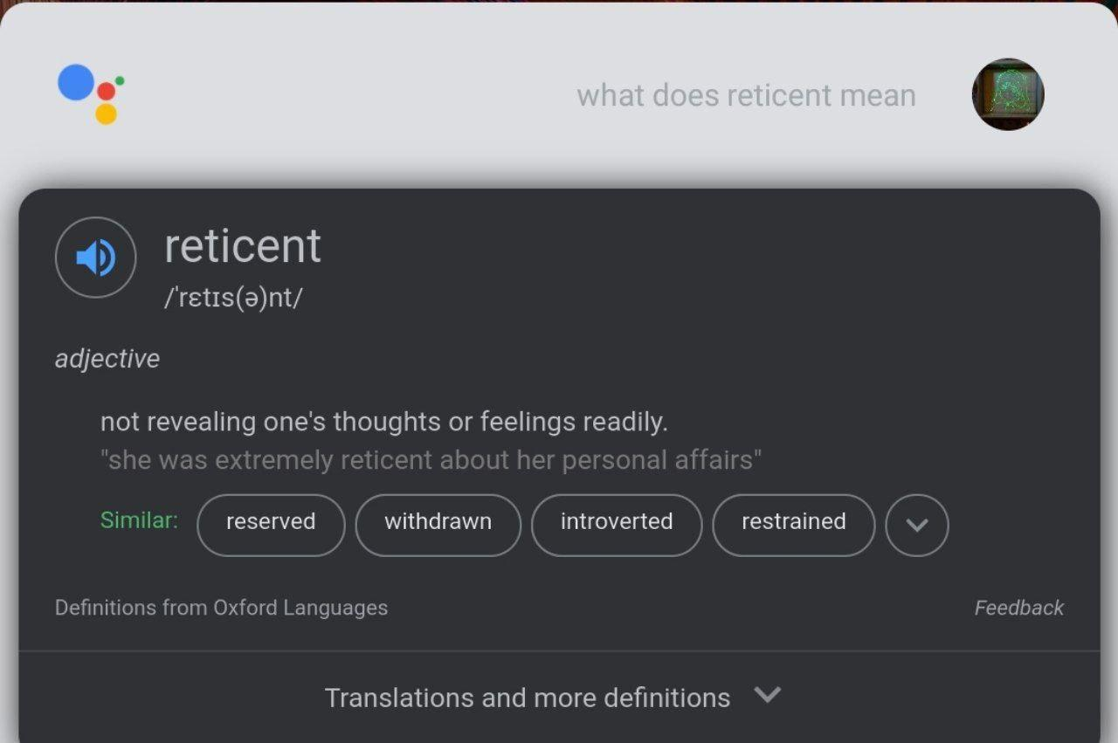
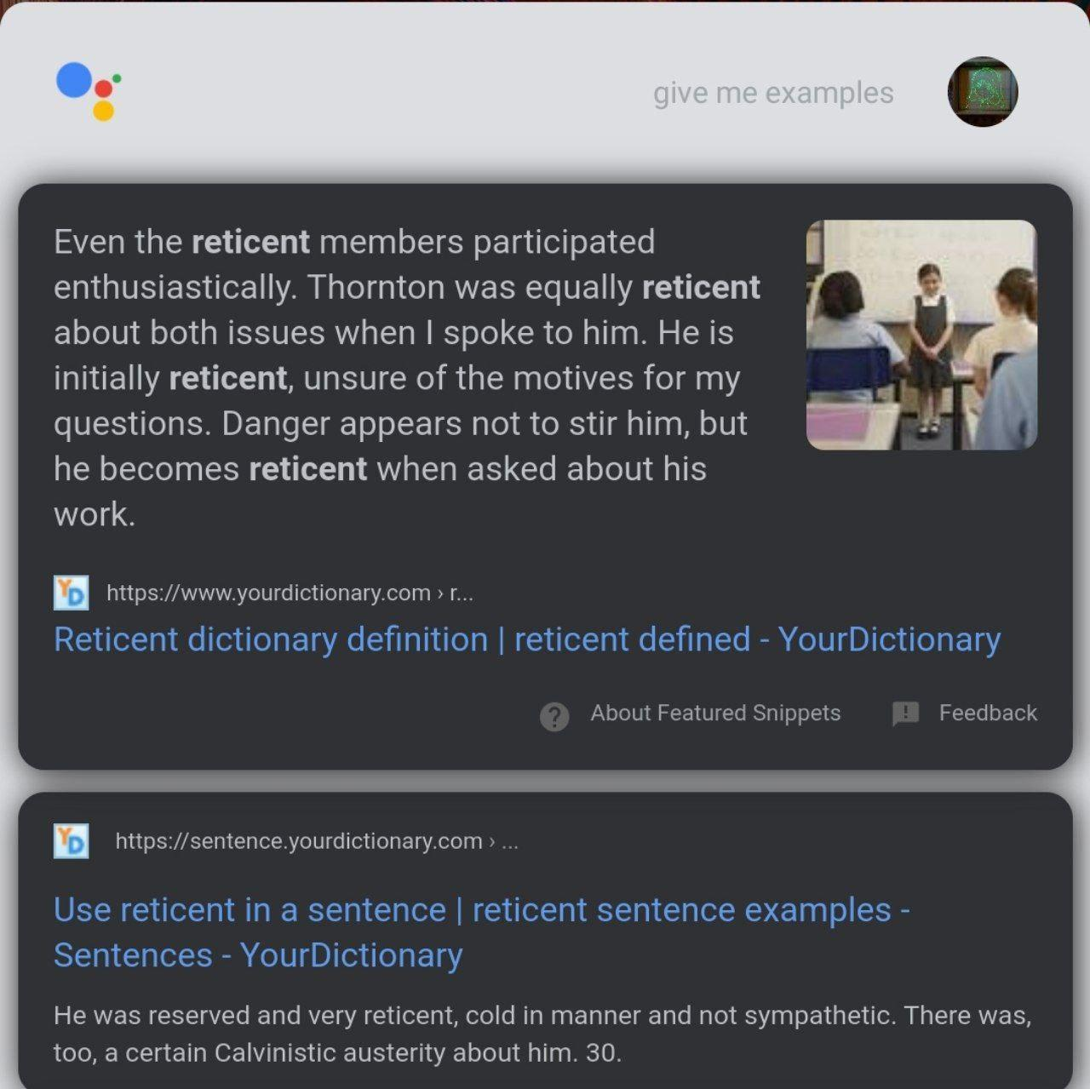
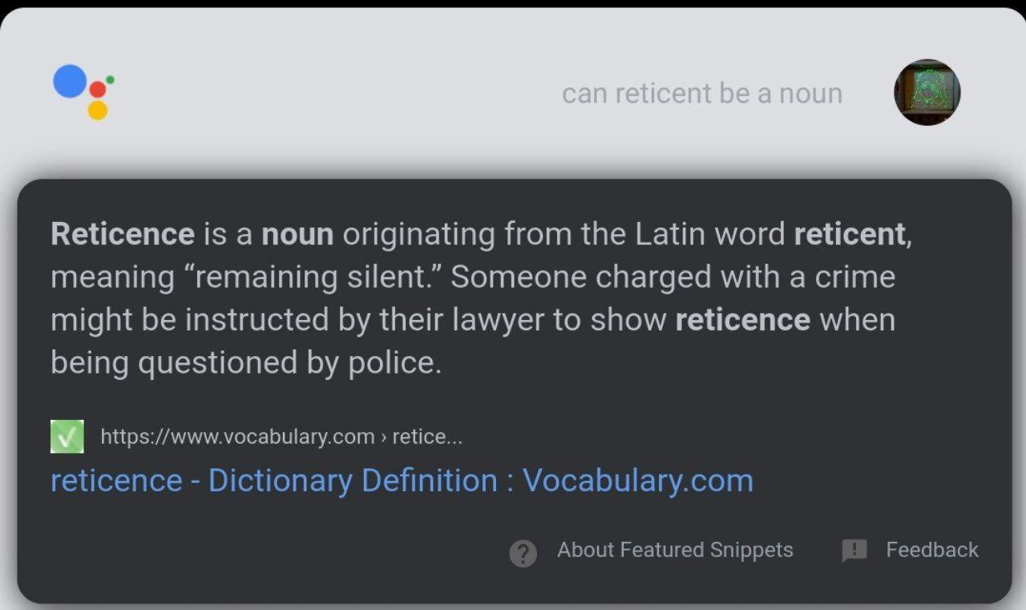
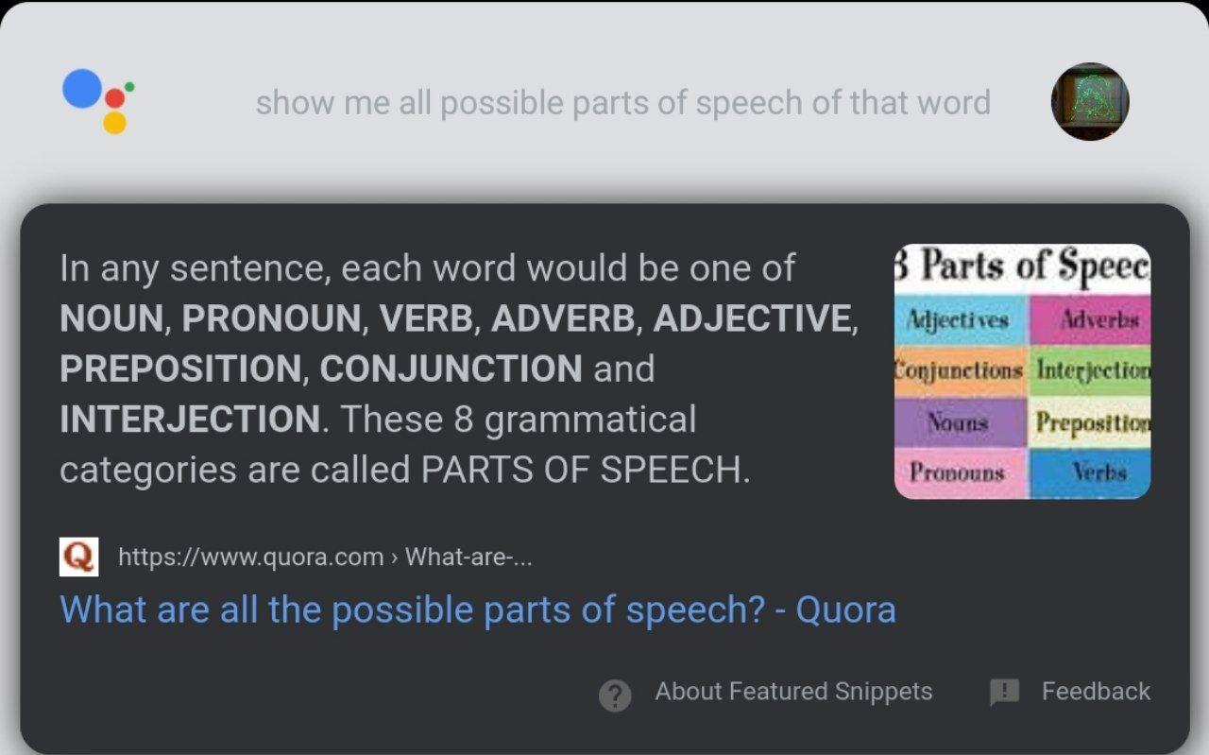
Limits of SOTA CAs
This is wrong in many ways!

Slide 6
The problem about evaluation
As far as we can tell, nobody has already tried a conversational agent dedicated to linguistics. Furthermore, no known linguistic conversational dataset has ever been compiled, making evaluation more difficult.
Google Home simply forwards the question as a normal Google query. It’s able to preserve a bit of context (arguably replaces the ‘its’ with past keywords) but it breaks quite easily after a few turns.
However, many IR systems work so far quite well because there is plenty of available datasets to query from.

Slide 7
ColLA*: A Conversational framework for Linguistic Agents
(colla: glue in italian)

Slide 8
Q1: What is a linguistic question?
From Wikipedia:
Linguistics is the scientific study of language.^{[1]} It involves the analysis of language form, language meaning, and language in context.^{[2]}
If there is plenty of datasets on languages, why is QA on linguistics difficult?
Linguistics is a ‘meta’ field, as sentences may not follow a traditional structure or diverge radically or merge different grammars or languages in a single utterance!
Utterances on linguistics are more difficult to find (compared to plain English prose, or even Scientific/Academic English used in research documents)
We are ‘less’ interested in “encyclopedic definitions”. One might say: “linguistic definitions are the ones that are not inherently encyclopedic”. But what does “encyclopedic” mean here?

Slide 9
Q1: What is a linguistic question?
(KG-centric definition) A linguistic question is a question that can be answered by a “linguistic” knowledge graph by only leveraging synsets, grammatical properties and syntactic or semantic pointers… where
Synset: synonym set, i.e. set of meanings associated with “lexemes”. If I replace a word with another one in the same synset the overall meaning does not change (e.g. partner/fiancé/boyfriend)
Grammatical property: POS, form…
Semantic pointer: antonym (opposite-of), meronym (is-part-of), hyponym (is-a), hypernym (is-a reversed) …
Main drawback of this definition: assumes all languages share the same underlying structure. Language philosophers have mixed views.

Slide 10
Q1: What is a linguistic question?
This allows us to greatly simplify our knowledge graph (no care in embedding other encyclopedic KG properties) at the cost of greatly downscaling the range of questions we can answer to.

Slide 11
Q2: What types of multi-term dialogue would users pose?
For example: “define ‘walnuts’”, “how would you say gentrification in German?”, “is luna a male or female noun in Italian?”, “show me synonyms for construction”
Excluded candidates: purely encyclopedic questions (“what are the other greek gods in the Pantheon?”, “Which countries did Christopher Columbus sail to?”);
  This goes in contrast with our ‘definition’ in Q1 as it requires more than just linguistic knowledge.
But this is *us* researchers making ‘artificial’ questions, not the end users.

Slide 12
Q2: What types of multi-term dialogue would users pose?
Our setting: we took the Google NLQ dataset, preserved the question and id alone and generated a Lucene index to query with Pyserini
  Used the first 10 ‘slices’ of Google NLQ from the train partition, for a total of 61477 examples
  stored docvectors + positions
  Default BM25 parameters: k1=0.9,b= 0.4 (we don’t really need reranking)
We hand-picked non-linguistic definitions

Slide 13
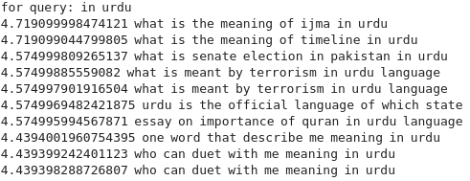
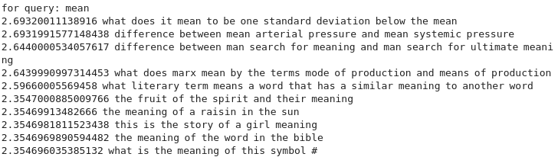
Q2: What types of multi-term dialogue would users pose?
We identified these clusters:
Definition (“What is the meaning of…?”)
How is X translated into Y? (“where X is usually a phrase”)
Questions on grammar rules (“where does the verb go in a german sentence”)
The rest is mainly encyclopedic questions.
Quite disappointing!

Slide 14
Q2: What types of multi-term dialogue would users pose?
How does a conversation continue? Does it even continue at all? Are current chatbots suitable for linguistic dialogues?
  “What does reticent mean” -> “Show me examples” clearly shows some coreference resolution going on, with the need of a context.
  “What does reticent mean” -> “Show me examples” -> “Can it be used as a noun” -> “What are all the others parts of speech available for that word” breaks apart.
We do not have an existing “natural” multi-turn dataset on language at hand.

Slide 15
Q3: What data sources can empower such system
A good bunch of KGs out there (Wikidata, DBPedia, Freebase, YAGO, BabelNet etc…)
  but their schemas (or ontologies) diverge radically!
Unstructured data sources (wiktionary, HC dictionary etc., Wikipedia, other encyclopediae)
  But they are “hard” to query, especially when looking for very structured information (e.g. morphology)
We want to achieve a certain level of generality and granularity, able to answer a range of questions in Q2
  Not trivial. Questions can range from “is ‘produce’ a noun or a verb?” to “give me an example of ‘salir’ in Spanish” to “define Neptune and give me correlated results”.
  The final KG may have to deal with ambiguities, examples and links to related entities (synonyms, hyperonyms, opposites, word frequency …). Some level of generality is wished.
  Novelty: forms of adjectives, verbs, nouns etc. as part of the KG. Very useful especially for highly flexed languages

Slide 16
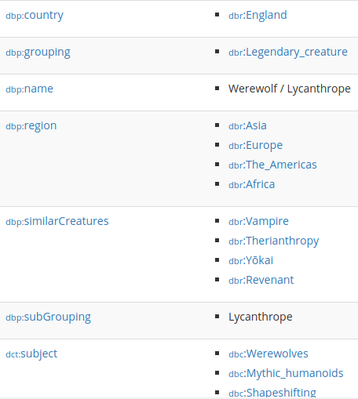
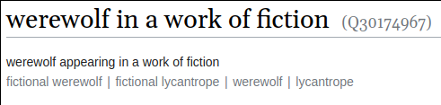
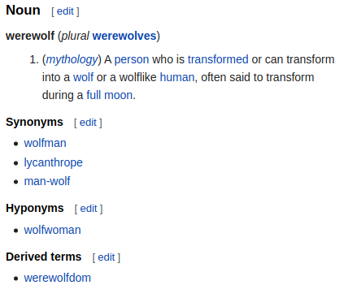
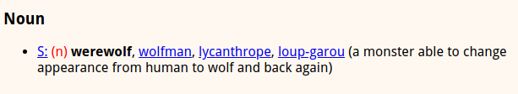

Slide 17
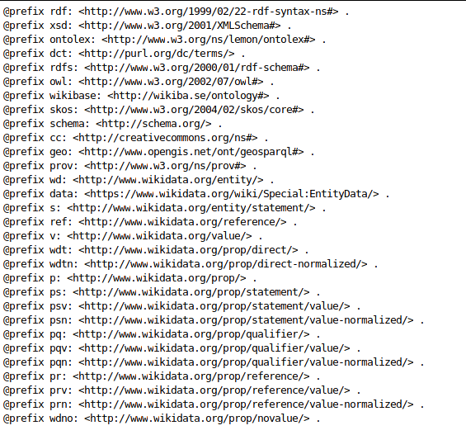
Used ontologies in Wikidata Lexemes
Different ontologies imply conceptual idiosyncrasies

Slide 18
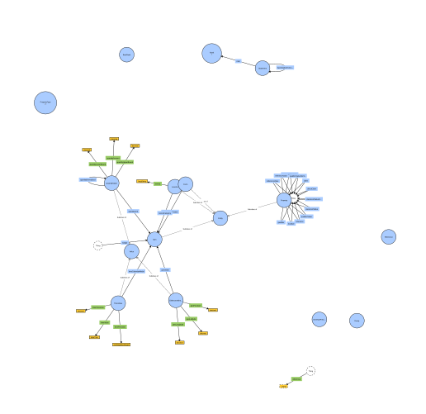
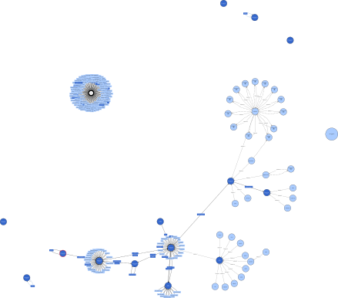
Lexinfo (“used” in BabelNet)
Wikiba.se for lexemes, used in Wikidata

Slide 19
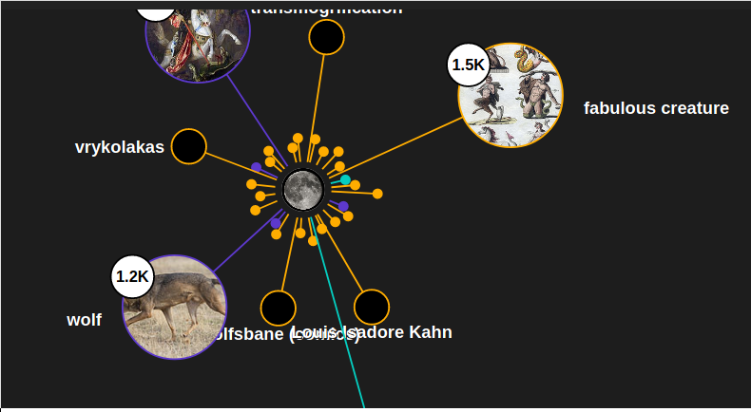
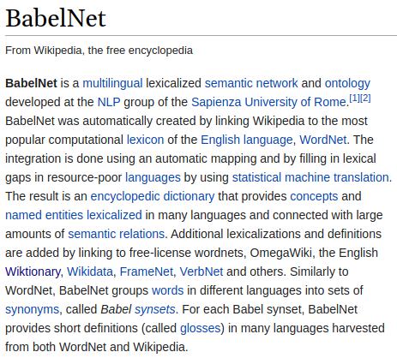
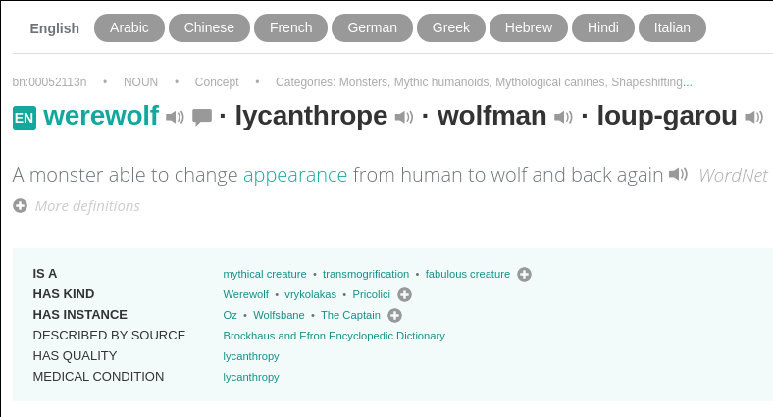
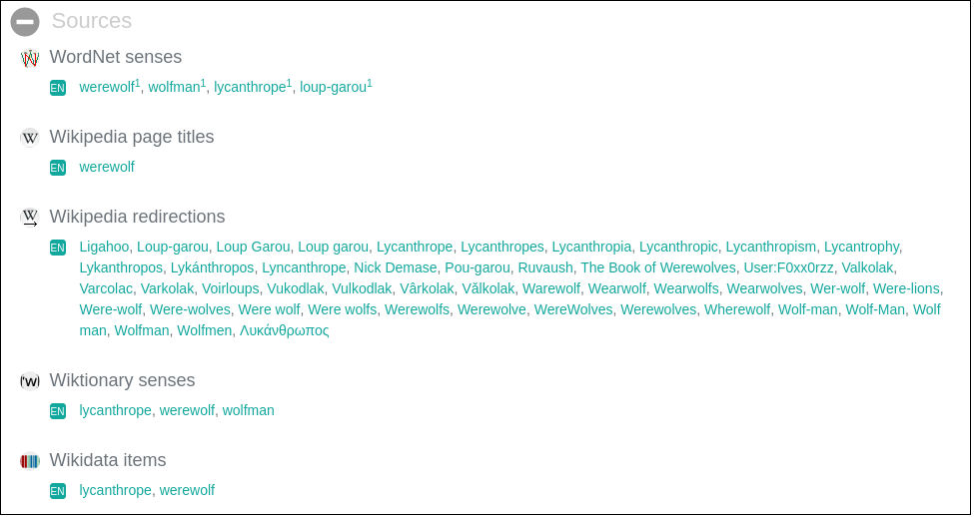
BabelNet

Slide 20
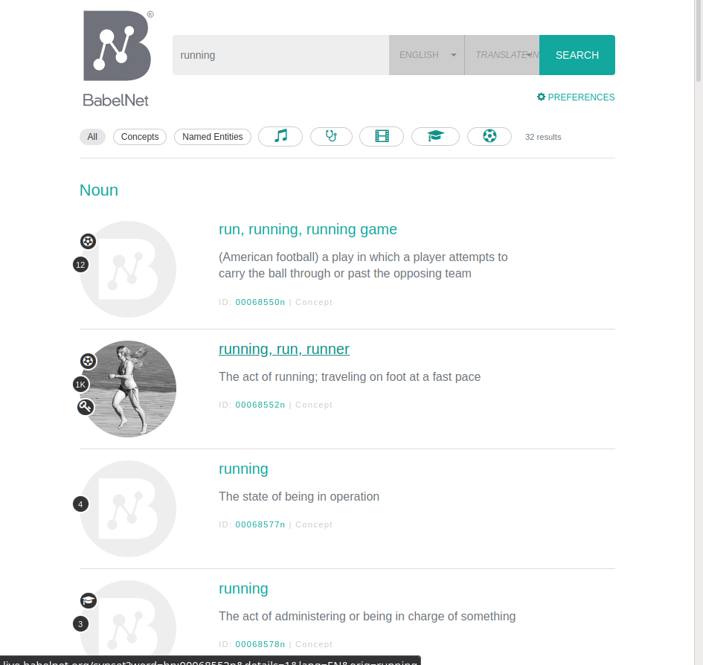
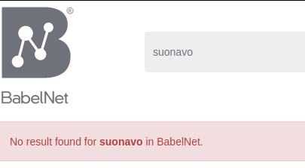
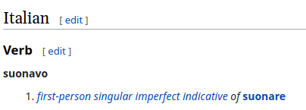
Forms are a no-go
Form-based search gives bad results on BabelNet, compared to wiktionary.

Slide 21
Our final choices for KG data sources
BabelNet
Embeds WordNet, VerbNet, YAGO, even Wiktionary sometimes - but also links with corresponding encyclopedic pages (e.g. dbpedia, wikipedia, wiktionary etc.)
Very linguistic knowledge graph
Also supports some translation
Closed source, Java-only API, not much introspectable or documented Lucene index.
Limited to nouns, verbs, adjectives and adverbs
Wiktionary
Has quite more entries than BabelNet
Virtually every English word type is available, including prefixes)
Users may still want word senses and actual language usages and examples
Includes quotations and form templates
More control on the parsing
Wiktextract is more python-friendly
The parser is not perfect (but neither BabelNet data is)

Slide 22
Knowledge Graph building
We leverage BabelNet and Wiktionary as much as we can,
  Sometimes we need to perform entity linking between senses and subsenses
  … or choose which POS taxonomy to use (beware, political decision!)
We sometimes use other data sources:
  Wikidata for a list of form types - basically anything useful BabelNet scrapped
The focus is not completeness, but QA! We pruned what we deemed unnecessary.

Slide 23
Our architecture (broad overview)
Wiktionary extraction
Entity Linking/Entity Disambiguation with BabelNet
RDF generation/serialization
Very full, complete dictionary with > 1M entries for the English language.
We leverage a patched version of Tatu Ylonen’s wiktextract
Associate senses with synsets. Synsets present more chances for sense clustering
Result can be thus imported into standard RDF graph visualizers and processors, e.g. SPARQL engines; or into Lucene documents for typical IR.

Slide 24
BabelNet entity linking
Pruned by lexeme comparison
(not really good idea)
WT
“Love”: Strong affection
Get all senses
S-BERT
Cosine sim
Create new synset in KG or ignore
S-BERT
Cosine sim
BabelNet
Synsets by lexeme
A strong positive emotion of regard and affection

Slide 25
Knowledge Graph Endpoints
How do we query the Knowledge Graph?
The graph has been serialized into RDF triples (e.g. Turtle) which can then be imported into any RDF-powered application (e.g. Python’s RDFlib) or SPARQL engines
  http://knowledge-glue-fuseki-jeffstudentsproject.ida.dcs.gla.ac.uk/
Lucene-based search. Good for fuzzy search:
  Searching for “rose” could match the main lexeme but also slightly related words like “rosemary” - or even a gloss of something else (“bunch”, as in “bunch of roses”)

Slide 26
Q4: how do we answer linguistic questions?
Existing models like BART, XL etc. are trained on casual or encyclopedic topics, not linguistic ones!
Actually, we lack a dataset to start with, let alone training/finetuning.
We adopt an intent/slot based question translation on a manually annotated small dataset of 50 utterances.
  Definitely not the “best” way to go, but offers a decent baseline for future work.
We provide a baseline for an answer, not really an answer.
Simple idea: we translate natural questions to intents, then we translate those intents into SPARQL queries.

Slide 27
Intent translation
Our baseline is a context-free grammar with > 140 rules and supports 4 intents:
Definition intent: fetch definitions for a given noun phrase.
  “define walnuts”, “what is a palombar”, “tell me what an airplane is”
Filter intent: give a “projection” of a previous definition entity.
  “What are possible examples?”, “what is the third-person present form of live?”, “show me more senses”
Related intent: give related word meanings.
  “What are possible synonyms?”, “show me some derived words”
Decide intent: like filter, but answers binary question (yes/no).
  “Can reticent be used as a noun”?

Slide 28
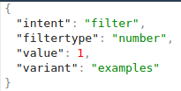

Intent translation example
Show me more examples for the third meaning

Slide 29
What does jeopardy mean?
Jeopardy (verb):
1. to put someone in danger
Query translation model
QA model
Update history
{“intent”: “define”, “np”: “jeopardy”}
Update history

Slide 30
What are synonyms?
Endanger
Put on a stake
Query translation model
QA model
Update history
{“intent”: “related”, “filtertype”: “synonym”}
Update history

Slide 31
PoC
http://knowledge-glue-webui-jeffstudentsproject.ida.dcs.gla.ac.uk/
Chatbot
Fuzzy searcher
KG visualizer
  You can also download an IRI file of the adopted KG ontology and visualize it with http://www.visualdataweb.de/webvowl )

Slide 32
Future work
Extract etymologies, phonems
Support multiple languages for word or ‘small phrase’ translation. The given data sources are rich enough to afford this, but form structure diverges by a lot.
Use seq2seq models for NLQ <-> intent translation, or even for direct KG query translation.
Use better entity linking mechanisms? S-BERT with LSH? Or a different model altogether?

Slide 33
So long, and thanks for all the fish

